Slide 1
EMERGENCE OF BANGLADESH BRITISH INDIA (1911-1947): NATIONALIST MOVEMENTS AND ROAD TO PARTITION

Slide 2
FROM THE FIRST WORLD WAR TO THE GOVERNMENT OF INDIA ACT OF 1919:
Partition annulment
WW1 outbreak
Revolutionary bombing
Dyarchy system

Slide 3
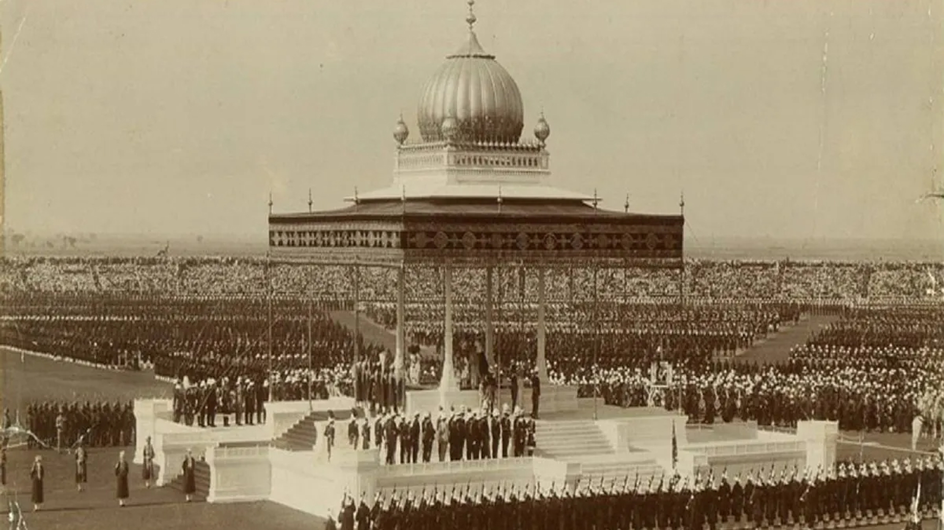
PARTITION ANNULMENT & SEPARATE ELECTORATES
Partition of Bengal reversed (1911)
Capital of the Raj is moved to Delhi
Bengal loses its preeminence in the subcontinent; as Curzon had originally hoped
Bengali muslims are unhappy at the loss their majority province; political mobilization remains; communal issues remain unresolved
1909: separate electorates are created for Hindus, Muslims and other religious/categorized communities

Slide 4

OUTBREAK OF WORLD WAR I
August 1914: outbreak of the first world war
Congress and the league pledge loyalty and collaboration in return for vague promises of ‘self-rule’
Over a £ 1 billion pounds sterling additionally extracted from the subcontinent as a ‘gift’
Food and grain forcibly seized from farmers to feed British, mercenary and other empire-allied forces
Famine-like conditions return to the subcontinent

Slide 5
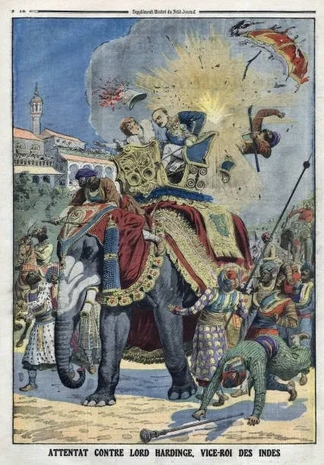
REVOLUTIONARY BOMBING
1912: Bengal revolutionaries bomb Viceroy during his inaugural entry to Delhi
Bengal new era groups, Sikh ‘Ghadar’ (‘rebellion’ or ‘mutiny’) and Pan-Islamist revolutionaries join hands with the German and Ottoman Empires in a bid overthrow the Raj
A provisional government is formed in Kabul
February 21, 1915: planned 1857-style uprising with German assistance fails
Rash Behari Bose, principal mastermind of 1912 and 1915 escapes to Imperial Japan

Slide 6
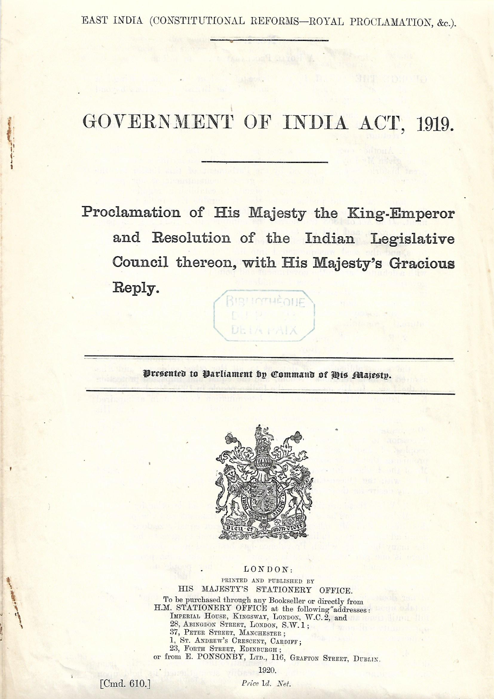
GOVERNMENT OF INDIA ACT OF 1919 (½)
At the end of the first world war; the British empire is victorious – but only just, and intent on re-establishing its supremacy as one of the leading world powers
The triumph of the Russian revolution introduces a dimension in world-politics; the first declared socialist workers’ state
No self-rule will be given by the Raj
Congress and the league discredited
Raj however offers concessions in the form of the government of India Act of 1919

Slide 7
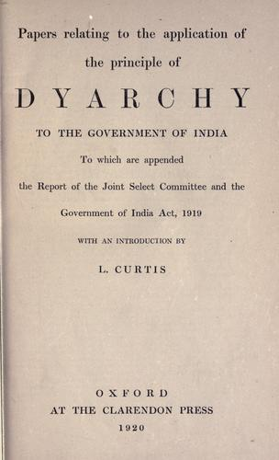
GOVERNMENT OF INDIA ACT OF 1919 (2/2)
Under the act:
Elections will be allowed to colonial provincial legislatures
Limited franchise
System of ‘dyarchy’; Raj provincial governors will share minor portfolios
Subcontinental peoples will also be allowed to run for municipal elections
Chittaranjan Das becomes the mayor of Calcutta; committed to expanding muslim participation in all spheres of bengali life
Appoints H.S. Suhrawardy as deputy major and starting his career in politics
Appoints 27 year old Subhas Chandra Bose as chief executive officer

Slide 8
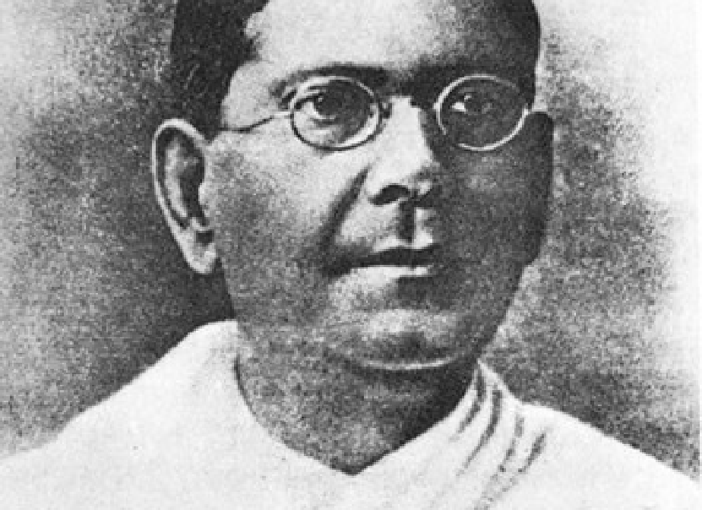

CHITTARANJAN DAS CAME OF AGE DURING THE BENGAL/INDIAN RENAISSANCE. POET, WRITER AND LAWYER, HE BECAME INVOLVED IN ANTI-COLONIAL POLITICS IN 1910 WHEN HE REPRESENTED NEW ERA DEFENDANTS. TREMENDOUSLY POPULAR MASS INDIAN LEADER, KNOWN AFFECTIONATELY AS ‘DESHBANDHU’ (‘FRIEND OF THE COUNTRY’) AND THE ‘UNCROWNED KING’ OF BENGAL, HELD THE UNCONDITIONAL RESPECT AND TRUST OF HINDU AND MUSLIM ALIKE. HIS DEATH IN 1925 WAS A SHATTERING BLOW FOR INTER-RELIGIOUS HARMONY IN BENGAL AND THE SUBCONTINENT.

Slide 9
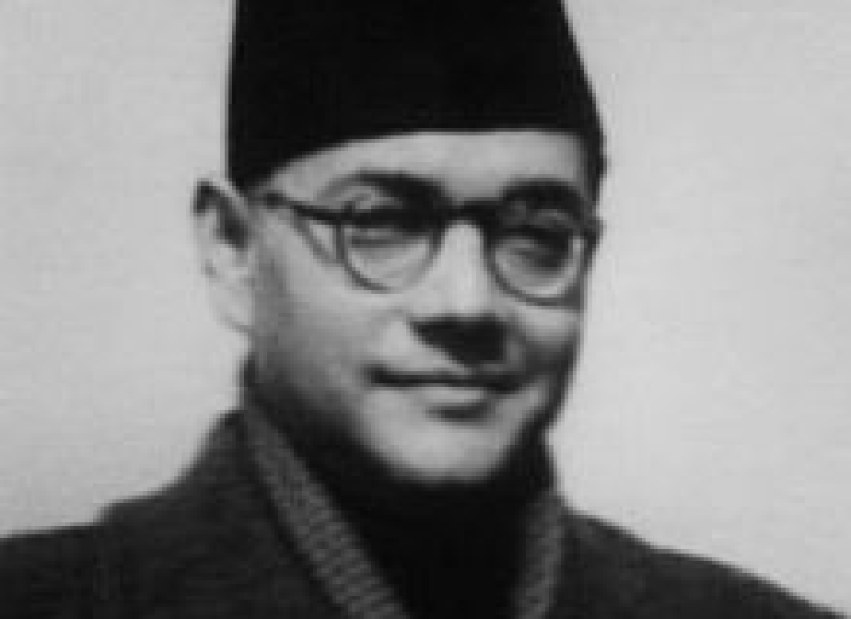

A BRILLIANT STUDENT OF PHILOSOPHY AT CAMBRIDGE UNIVERSITY, SUBHAS CHANDRA BOSE WAS THE FIRST INDIAN TO RESIGN VOLUNTARILY FROM THE FORMIDABLE RAJ BUREAUCRACY – THE SO-CALLED ‘BRITISH INDIAN CIVIL SERVICE’ – IN 1921.
IMPRISONED ELEVEN TIMES BY THE RAJ FOR ANTI-COLONIAL ACTIVITIES AND AS EARLY AS THE 1930S WAS SECRETLY ACKNOWLEDGED BY LONDON AS THE ONE “IMPLACABLE FOE OF BRITISH RULE” IN THE SUBCONTINENT.

Slide 10
FAILURE OF SATYAGRAHA-KHILAFAT TO THE START OF THE SECOND WORLD WAR,
Gandhi’s Leadership

Slide 11
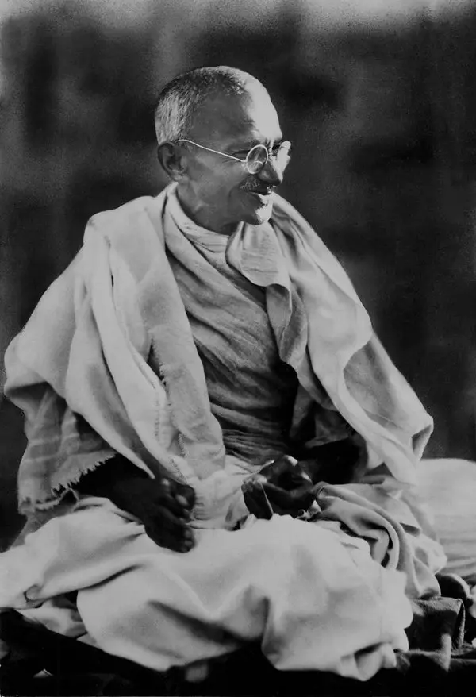
SATYAGRAHA-KHILAFAT MOVEMENT OF GANDHI (1/2)
The legend of Mohandas Karamchand Gandhi, the ‘great-souled’ one or the Mahatma to his followers and admirers
From the Gujarat region
Brief career in law
Awakened to injustice in British occupied Southern Africa
Fashions the tactic of ‘Satyagraha’ or ‘Struggle In Truth’ as a disobedience method
Returns to the subcontinent after the start of the first world war and is given the leadership position of congress in 1920 after its failures to force concessions from the Raj

Slide 12
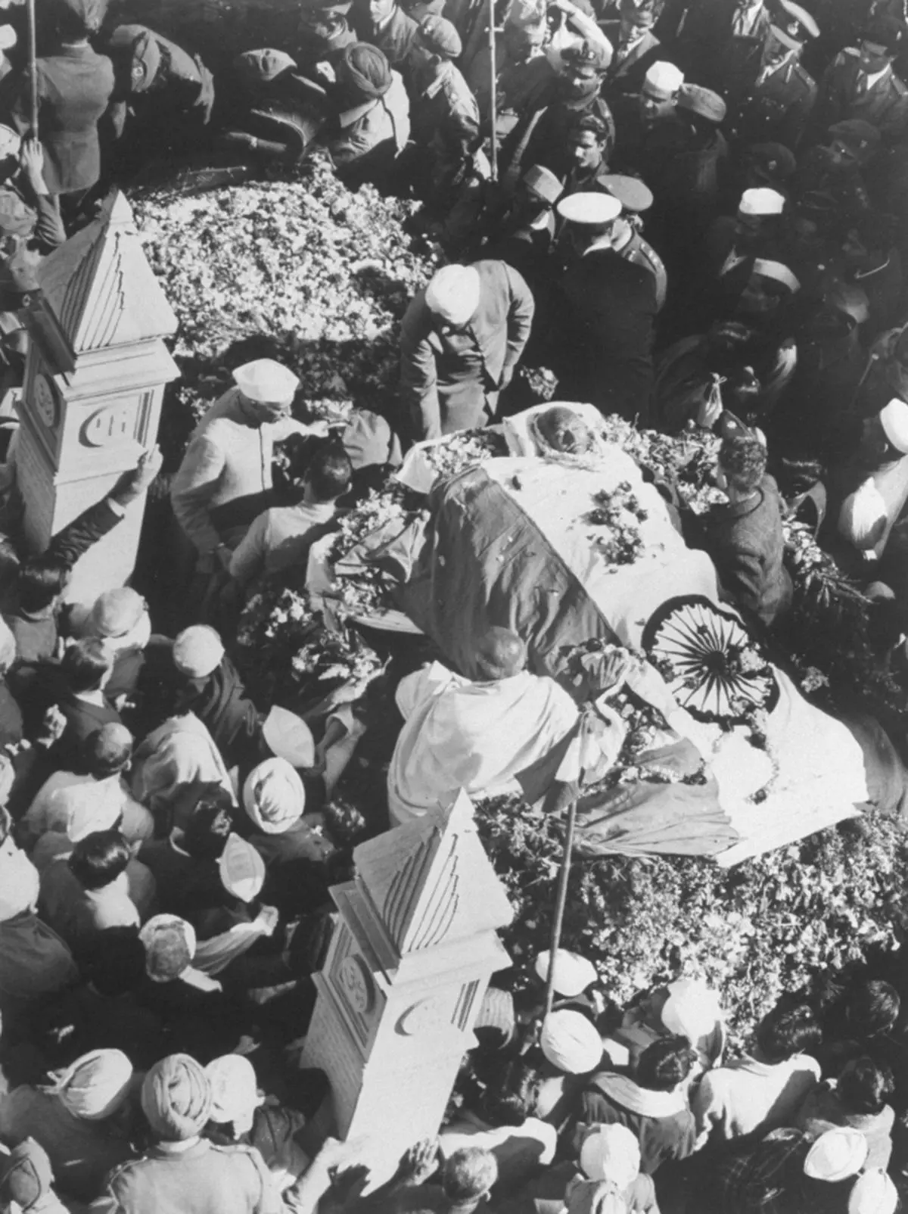
SATYAGRAHA-KHILAFAT MOVEMENT OF GANDHI (2/2)
Gandhi leads three movements; Satyagraha-Khilafat (1921-1922), The Salt Tax Satyagraha (1930) and The Quit India Movement of 1942
Combines ‘self-suffering’ with strict non-violent civil disobedience
During 1946-1947 tries to mitigate communal riots
Assassinated by a Hindu extremist in 1948

Slide 13
THE COMPLEX LEGACY OF GANDHI (⅕)
The reality is more complex than the legend;
Gandhi constructs his worldview in late-19th century England and imbibes his initial understanding of Hinduism from fringe (marginal) elements in London
Also absorbs ideas from the cult of theosophy
The end result is a mixture of Hinduism and Missionary Christianity
Wants to achieve Moksha (spiritual perfection) for himself and to establish a Ram Rajya (‘kingdom of Lord Rama’) in the subcontinent
His self-invested missionary objective means his view of the British empire is at odds with Swaraj

Slide 14
THE COMPLEX LEGACY OF GANDHI (2/5)
His wish is not to force the British Empire from the subcontinent but to forge a friendship for his worldly goals
To achieve this friendship he wishes to only put pressure on the Raj (the British may leave on their own if they wish)
In 1921 Gandhi admits to French philosopher Paul Antoine Richard that independence for the subcontinent is not as important for him as his global missionary objective
In practical terms there are also problems; in Southern Africa, Gandhi had both made horrible racist statements against indigenous peoples and supported the brutal British suppression of african anti-colonial uprisings

Slide 15
THE COMPLEX LEGACY OF GANDHI (3/5)
During the first world war; Gandhi volunteers to raise mercenary recruits to fight for the Raj – a direction contradiction of his claim to be a strict pacifist
In conjunction with this Gandhi is totally opposed to the armed revolutionary tradition, its objectives and militant freedom fighters
Gandhi also has a practice of claiming leadership in ongoing struggles or campaigns – creating the perception he had been the originator of the agitations – and abandoning any in which he cannot obtain an advantage for himself – Historian Judith Brown

Slide 16
THE COMPLEX LEGACY OF GANDHI (4/5)
Gandhi also believes that his engagement with the ‘truth’ has placed him above the realities of politics and beyond responsibility for his words or actions
Gandhi is honest about his religious outlook but uses it to invoke support; but at the cost of alienating minorities and lower-caste Hindus
he also willfully obstructs those, like Chittaranjan Das and later Subhas Chandra Bose who were trying to build bridges across the religious divide
Gandhi’s religious outlook is also heavily influenced by his powerful financiers, who are openly communal as a group

Slide 17
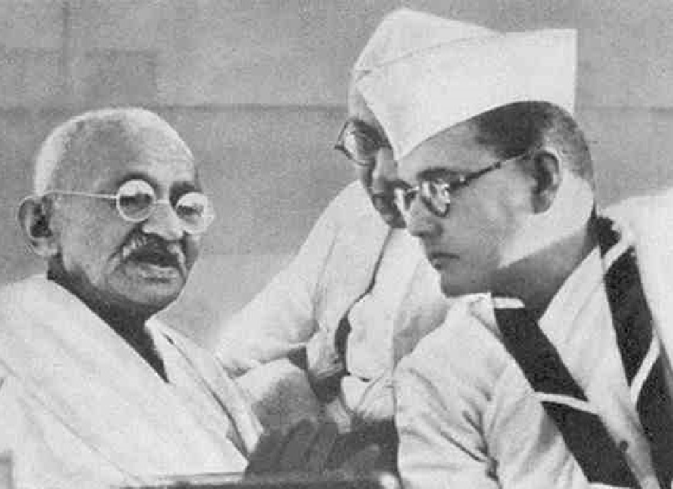
THE COMPLEX LEGACY OF GANDHI (5/5)
Gandhi, who ascended to the supreme leadership of Congress after 1920 was bitterly opposed to the armed revolutionary tradition and saw in them his principal and hated rivals.
By the 1930s, Subhas Chandra Bose was the one mass leader in the subcontinent who envisioned an armed revolution to completely kick out the Raj.
Karamchand Gandhi(left) with Subhas Chandra Bose(right) during a brief period of ‘truce’, Haripura Congress Session, 1938

Slide 18
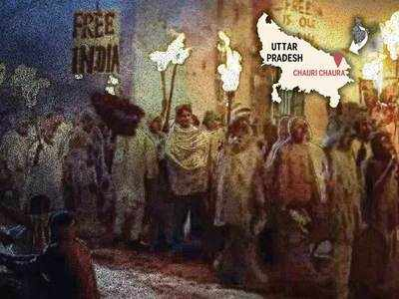
FROM THE FAILURE OF SATYAGRAHA-KHILAFAT TO THE START OF THE SECOND WORLD WAR
Realizing that he cannot bring Muslims into a joint agitation of pressure against the Raj without a secular mantle, Gandhi promises to save the Ottoman Emperor Or ‘sultan’ who also claimed to be the Caliph of Islam
In the process Gandhi joins hands with communal Muslims
The arbitrary calling off of the movement after the redemptive acts of farmers at chauri-chaura (united provinces) worsens the religious and political situation across the subcontinent
Ordinary people are so angry that there is no reaction when Gandhi is imprisoned for a few months
Deshbandhu Chittaranjan Das decides to take on the issues dividing hindu from Muslim first in Bengal and then propose it as a model for the subcontinent

Slide 19
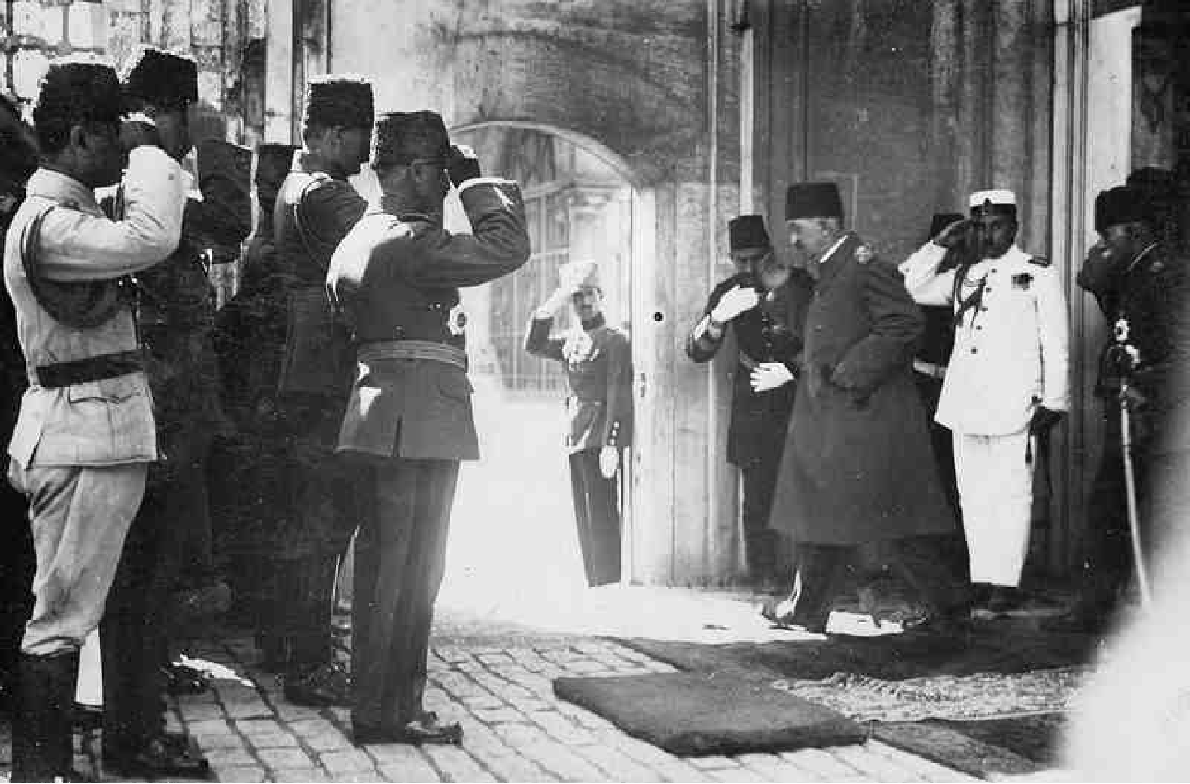
THE FINAL DEPARTURE OF MEHMED VI,
LAST SULTAN OF THE OTTOMAN EMPIRE

Slide 20
THE LEGACY AND CHALLENGES OF LIBERAL POLITICS

Slide 21
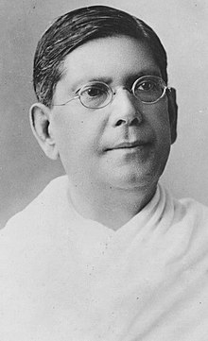
BENGAL PACT OF DESHBANDHU
Bengal Pact of 1923:
Institutional seating and distribution of jobs will be based on the population breakdown of Bengal by religion
60% of seats will be reserved for Muslims and 40% for Hindus
For official job appointments; 55% of positions will be reserved for Muslims but until they reach the 55% mark 80% of all new positions will be given to Muslims
No one will be allowed to play music in front of mosques during prayer times & cow slaughter will only be allowed for the Islamic feast of the sacrifice
All the clauses will be supervised by joint boards at all levels

Slide 22
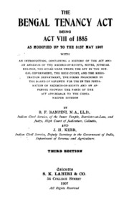
BENGAL PACT and TENANCY ACT
When the pact is put forward at the Kakinada session of congress gandhi and his allies have it struck down
In Bengal however the pact is upheld
June 1925: the unexpected and tragic passing of the Deshbandhu leaves a tremendous void
Subhas Chandra Bose is not released from arbitrary imprisonment by the Raj for two years under horrific conditions until 1927
Congress, already unpopular with Bengali Muslims for 1922 becomes even more suspect with the opposition to the Bengal Tenancy Act of 1928

Slide 23
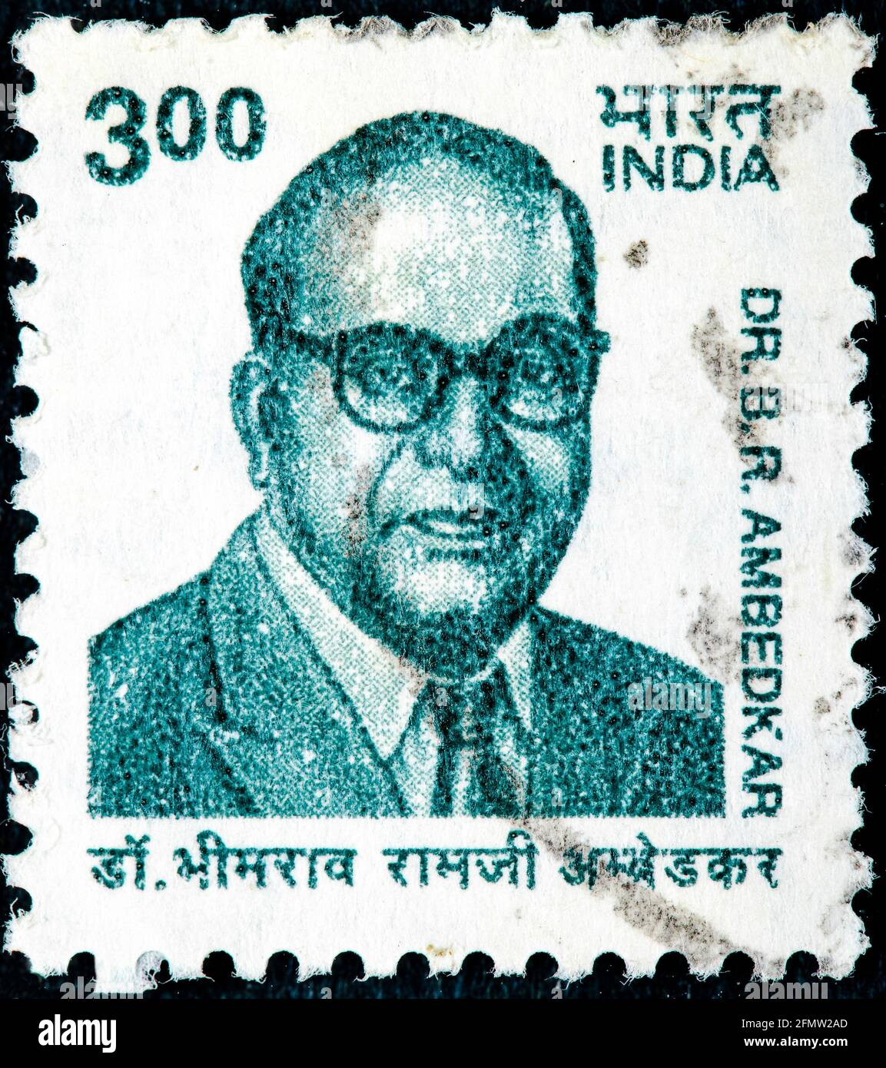
THE RISE OF DALIT POLITICS
Early 20th century muslim political mobilization runs parallel to awakening of Dalit (‘broken’ or ‘oppressed’) mass consciousness
The counter-reaction is the creation of organizations such as the Hindu Mahasabha (‘Hindu general assembly’) and Rastriya Swayamsevak Sangh (‘national Volunteers’ Association’)
These eventually turn their focus against Muslim mobilization as well
Bhimrao Ramji Ambedkar is the leading figure amongst the Dalit leadership who exposes Gandhi’s attitudes towards the oppressed lower castes

Slide 24
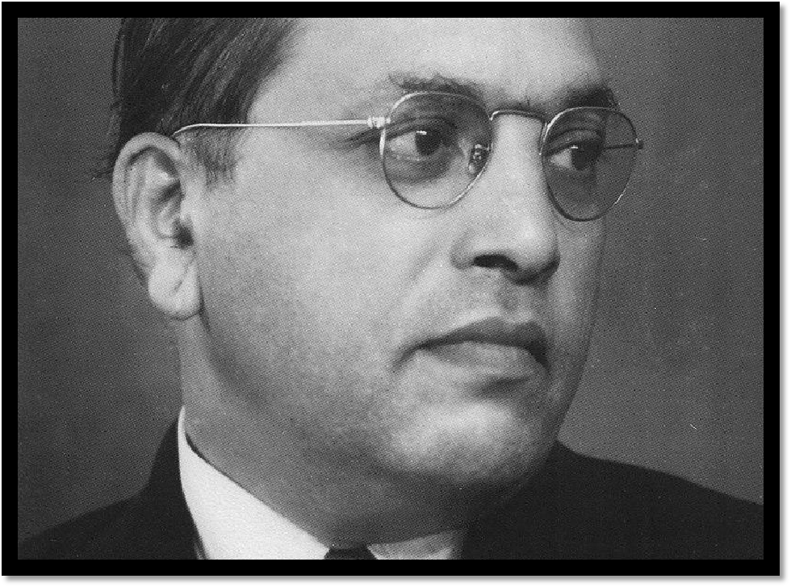

ONE OF THE FOREMOST DEFENDERS OF THE DALIT (OPPRESSED CASTES) COMMUNITY DURING HIS LIFETIME.
BITTERLY OPPOSED CASTE PREJUDICE, SINGLE-HANDEDLY TOOK ON KARAMCHAND GANDHI IN THE 1920S, 1930S & 1940S, WHO WAS FORCED TO CLARIFY HIS SUPPORT THE CASTE SYSTEM.
AMBEDKAR WAS PRESSURED TO SIGN THE POONA PACT IN 1932, A DECISION HIS REGRETTED TO THE END OF HIS LIFE.
CONVERTED TO BUDDHISM BEFORE HIS DEATH.

Slide 25
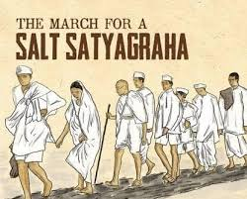
ANTI-COLONIAL AGITATIONS:
In 1930 Gandhi launches the Salt March Satyagraha; it is carefully choreographed and publicized – its objectives even less ambitious then in 1921-1922 focusing on the Raj taxation on salt-making by coastal communities
Parallel agitations are launched
A more dramatic and worrying armed uprising is attempted by primarily Bengal revolutionaries in the port of Chittagong in April 1930
While links to the port from the rest of the Raj are cut off for a few days, an incorrect strategy – guerrillas facing a regular army on open ground proves tragic for the freedom fighters

Slide 26
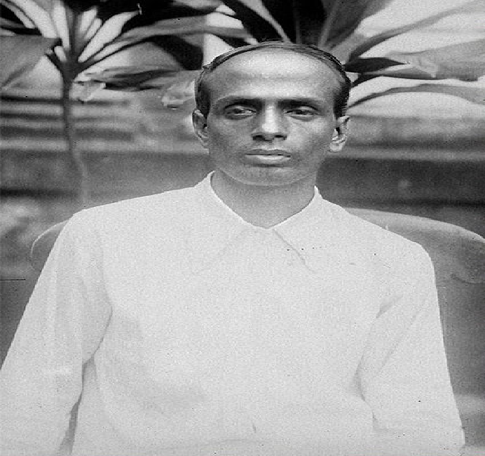
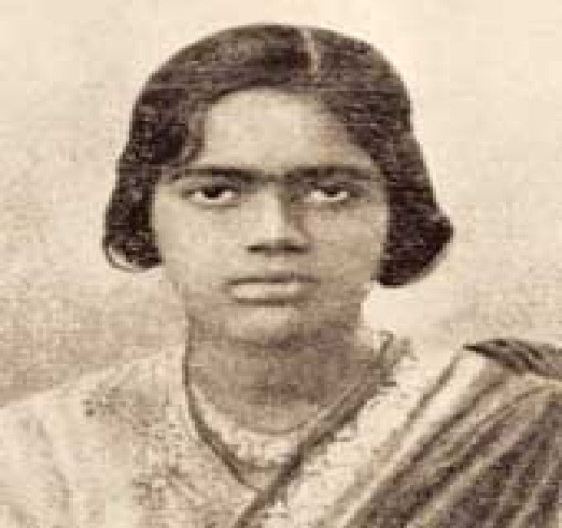


FREEDOM FIGHTERS OF THE CHITTAGONG UPRISING 1930

Slide 27
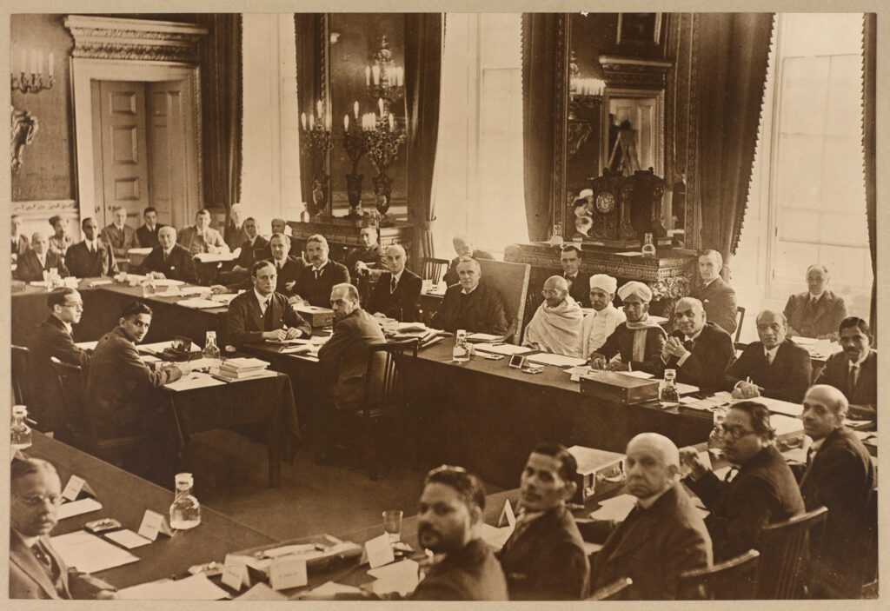
ROUND TABLE CONFERENCES (1931-32)
During 1931-1932 the Raj invites leaders of all parties and collective interests to London for a series of so-called Round Table Conferences
Gandhi, insisting on representing congress alone, is completely outmaneuvered by other Raj collaborators
The Raj at the end announces the ‘Macdonald Award’ – after the British Prime Minister James Macdonald – although more commonly known as the Communal Award
In Bengal, it reduces representation in the colonial legislative assembly for the upper-caste Hindu middle-classes

Slide 28
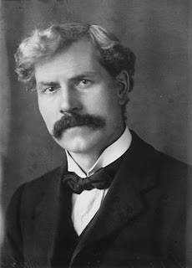
MACDONALD AWARD AND ITS CONSEQUENCES
To participate in the colonial legislative now means being a powerless minority
Caste anger – instead of being directed against the British – is targeted at the perceived beneficiaries of the award; Bengali Muslims
Many caste Bengali Hindus now begin to turn away from the nationalist, anti-colonial cause.
Bengali Muslim opinion regarding the award is varied but generally they were already more confident of holding their ground and having a fair say in the affairs of Bengal alongside their Bengali Hindu brethren before the award

Slide 29
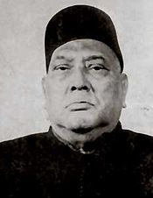
RISE OF BENGALI POLITICS, THE KRISHAK PRAJA PARTY
In the early 1930s an umbrella party is formed to represent primarily non-elite Bengali Muslims and farmers;
Krishak Praja Party (‘ Peasants And Tenants Party)
It is an umbrella organization with figures such as A.K. Fazlul Huq in the leadership
The so-called Government Of India Act Of 1935 allows for further expansion of the Bengali Muslim franchise

Slide 30
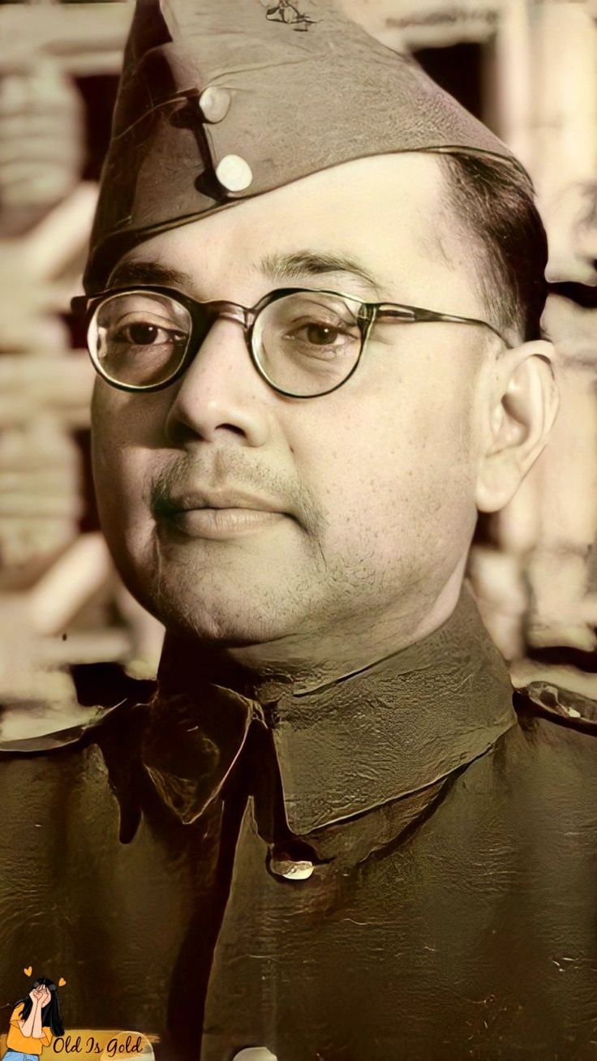
RISE OF LEFTIST POLITICS IN BENGAL
Subhas Chandra Bose and elder brother Sarat Chandra Bose, as part of the Provincial Bengal Congress had been gradually working towards the creation of an alliance with the KPP And other progressive organizations in Bengal in the 1930s – to resolve Bengali issues with Bengali solutions
Subhas Chandra Bose faces not just the principal enemy, the Raj but domestic enemies including the business elites who wish for an accommodation with the Raj
Under the framework of the 1935 act, two years later elections are held for the colonial provincial assemblies

Slide 31
RISE OF LEFTIST POLITICS IN BENGAL
While Congress wins in a majority of the provinces (8/11) there is a problem; it has failed to win Muslim support, being unable to field Muslim candidates in many seats
Congress also backtracks on a pre-election promise to go into coalition with the league
In Bengal, instead of allowing the local congress to go into coalition with the KPP, Gandhi – at the behest of his communal financial backers – rejects it, thus paving the way for the kpp’s fateful coalition with the league
The league, previously unable to connect with Bengali Muslim peasants now is able to do so through the KPP

Slide 32
SUBHAS CHANDRA BOSE
(THE STRUGGLE FOR LEADERSHIP IN CONGRESS) (1-2)
In 1939 Subhas Chandra Bose won re-election to the annual position of congress president – against Gandhi’s open opposition
The Raj noted that Gandhi and his followers had freely bribed congress delegates to vote against Subhas Chandra Bose
This illustrated that popular sentiment was behind a more dynamic and militant approach to the anti-colonial struggle
However, through a series of undemocratic maneuvers – including mistakes made by Subhas Chandra Bose – Gandhi forced the defeat of his arch Bengali rival

Slide 33
SUBHAS CHANDRA BOSE
(THE STRUGGLE FOR LEADERSHIP IN CONGRESS) (2-2)
Between 1939 – 1940, not content with the defeat of Subhas Chandra Bose, Gandhi had him and his supporters expelled from the organization – a process that continued into 1945
Thus, the Bengal congress in the lead up to 1946-1947 was an entirely communal entity
Subhas Chandra Bose had wanted to remain as the head of the largest political organization as the second world war was about to break out in september 1939

Slide 34
FROM THE START OF THE SECOND WORLD WAR TO DOMINION STATUS (AUGUST 1947)

Slide 35
FROM THE START OF THE SECOND WORLD WAR TO DOMINION STATUS IN AUGUST 1947
On September 1ST, 1939 Germany invaded Poland
On September 3RD, 1939, John Hope, the Imperial Viceroy – without consulting a single Indian, not even collaborators and thus showing that the 1935 act of ‘Devolution’ of power, had been a sham – declared that the Indian subcontinent on behalf of the British empire was at war with Germany
The British Intend to use the subcontinent as an industrial plant and supply centre during its war against its enemies
The league and the communal parties immediately and openly pledge their collaboration to the Raj

Slide 36
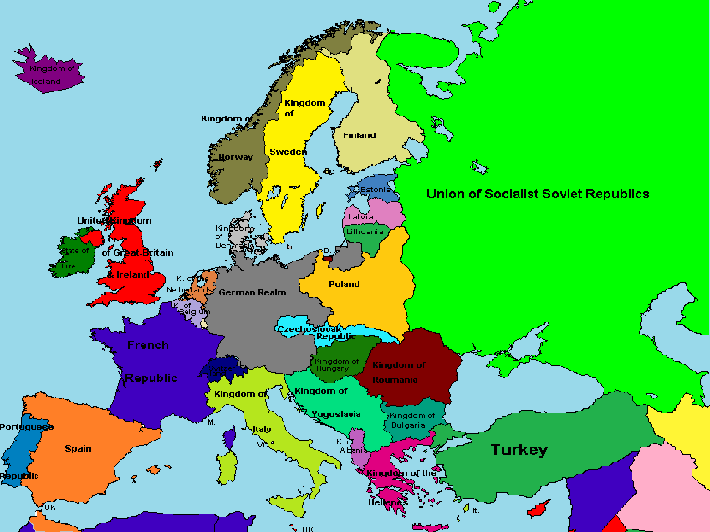

Slide 37
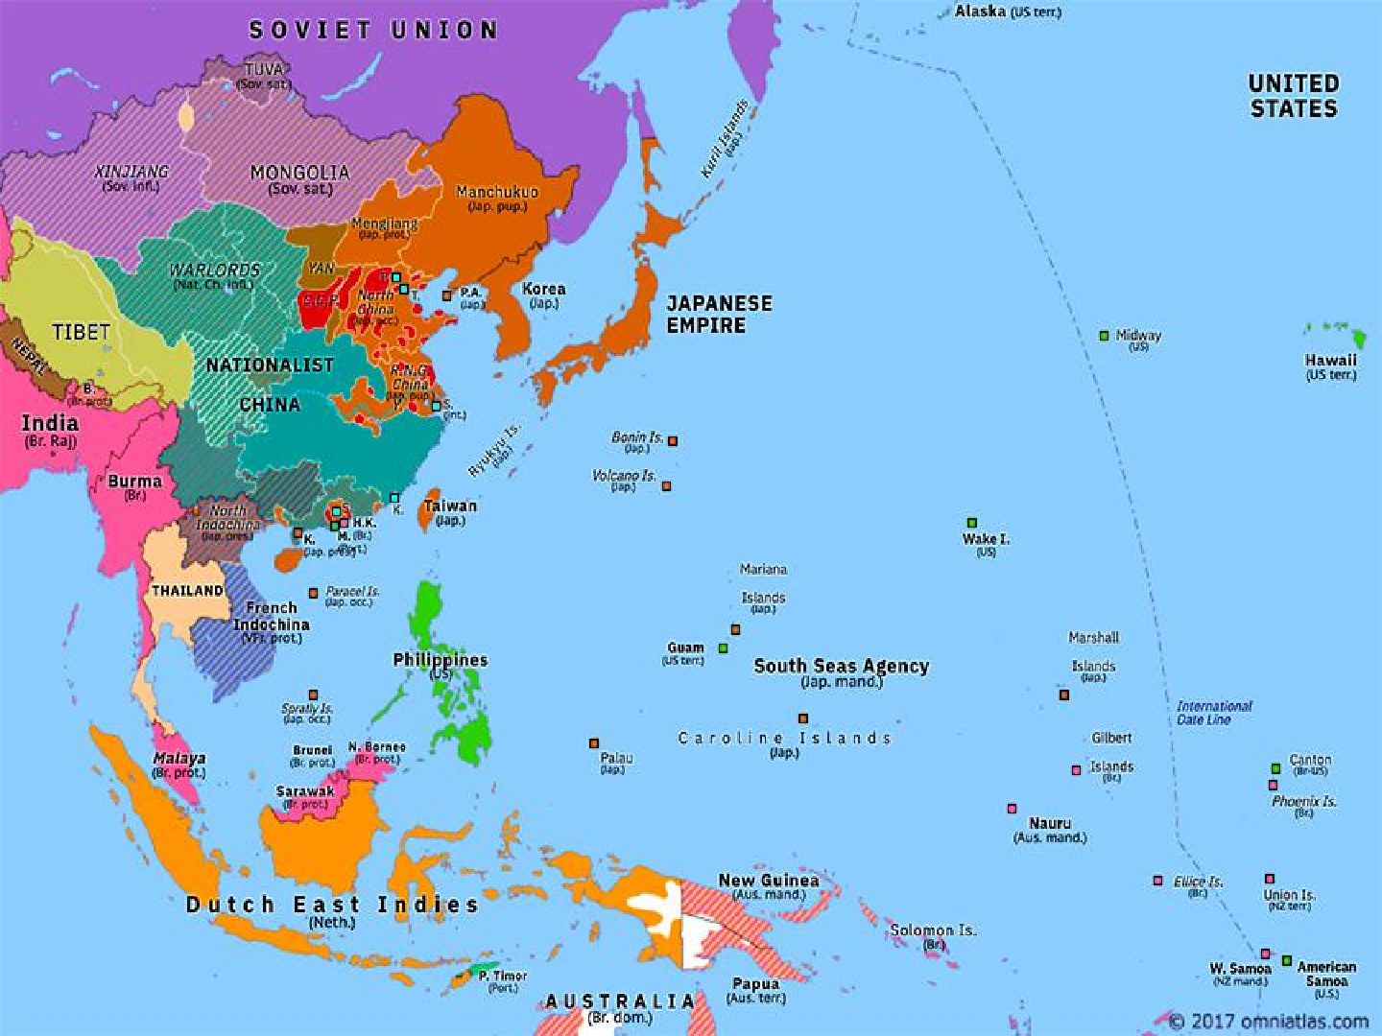

Slide 38
FROM THE START OF THE SECOND WORLD WAR TO DOMINION STATUS IN AUGUST 1947
Gandhi and congress initially want to pledge their support to the Raj but backtrack when they realize that public opinion is against participation
Subhas Chandra Bose, who has now formed his own party, the Forward Bloc, is clear about what the war means – an opportunity for the subcontinent to strike for her freedom
In 1940 Subhas Chandra Bose finalizes a plan to escape from the subcontinent – and join hands with the enemies of the Raj and organize a movement from abroad

Slide 39
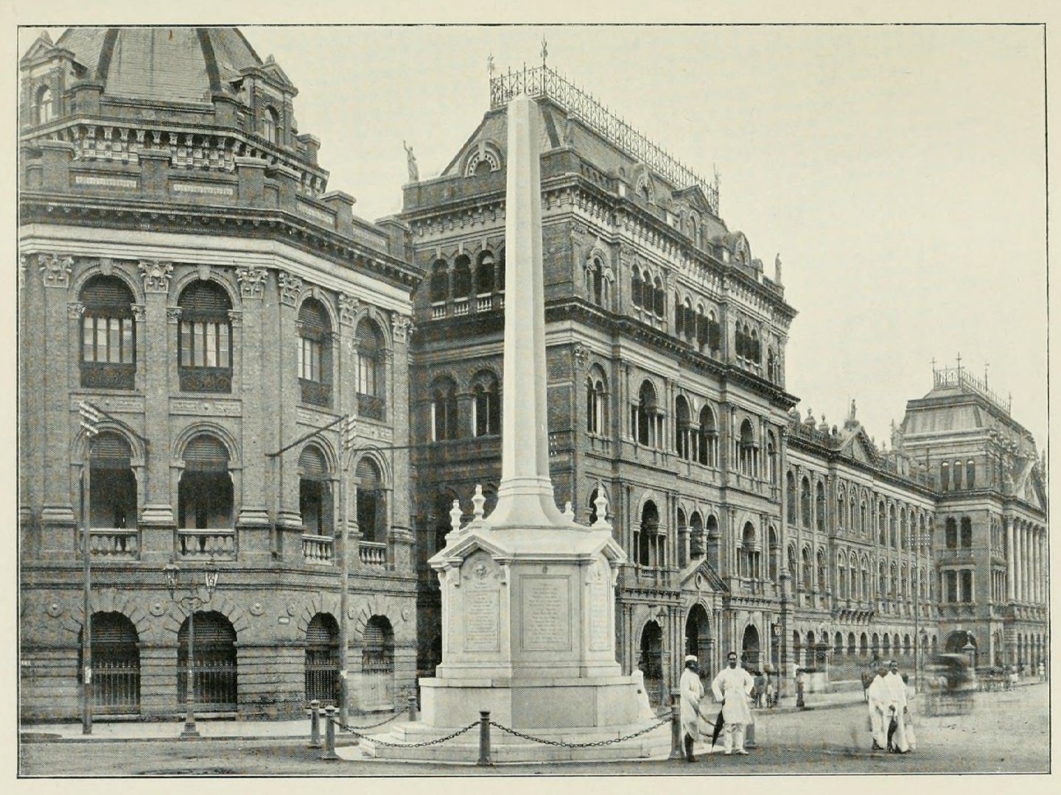

Slide 40
FROM THE START OF THE SECOND WORLD WAR TO DOMINION STATUS IN AUGUST 1947
In Bengal during 1941 – 1943 the KPP, the Forward Bloc and the Mahasabha form a unique coalition colonial legislative administration
In the end the Raj and the League tricked Fazlul Huq into its dissolution
While it did not have any powers of consequence – how such a coalition might have handled the events of 1946-1947 remains a thoughtful question

Slide 41
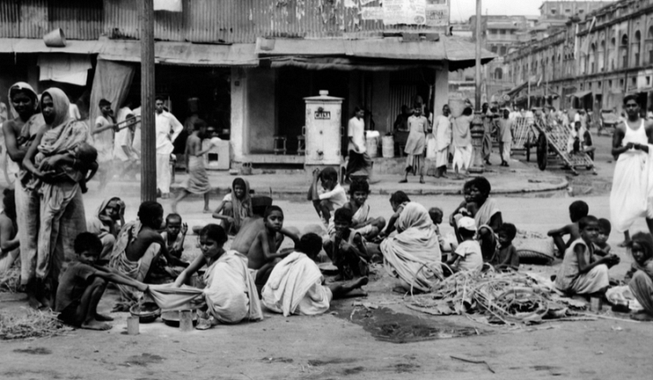
BENGAL FAMINE (1943)
The Bengal Famine of 1943
As with other British engineered famines; the issue was not one of the availability of food – but access to it
The Raj had taken a deliberate decision that food would only be given to those sections of the populace who were of ‘use’ to their war effort
Between 3 – 5 million innocent Bengalis perish as a result

Slide 42
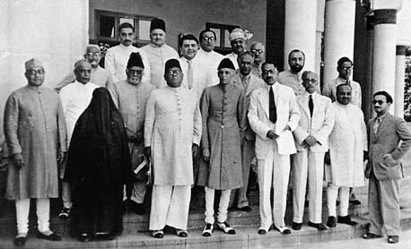
LAHORE RESOLUTION
March 1940: the Lahore resolution is announced – no reference to an entity called ‘Pakistan’ – but the call is made to the Raj to make provisions for Muslim-majority provinces in the event of a British departure from the subcontinent
Until 1943 Mohammad Ali Jinnah, The principal leader of the league, refuses to entertain the term ‘Pakistan’
In 1946 Jinnah removes the reference to ‘provinces’ or ‘states’ and makes it a singular state

Slide 43
SUBHAS AND THE FORMATION OF AZAD HIND FAUJ
In January 1941, Subhas Chandra Bose dramatically escapes the British-occupied subcontinent. In April, he reaches Berlin, the capital of National-Socialist Germany.
Subhas Chandra Bose’s signal importance is underlined by the fact that he was officially targeted for assassination by the British government after January 1941, with such instructions given to all British forces.
From captured mercenaries and civilians, he forms the Free India Legion. For the first time since 1857, a leader of the subcontinent has successfully formed a military unit loyal to the peoples of the subcontinent and not the Raj.
However, he is frustrated in not being able to participate in the mass uprisings that break out after August 1942 across the subcontinent.

Slide 44
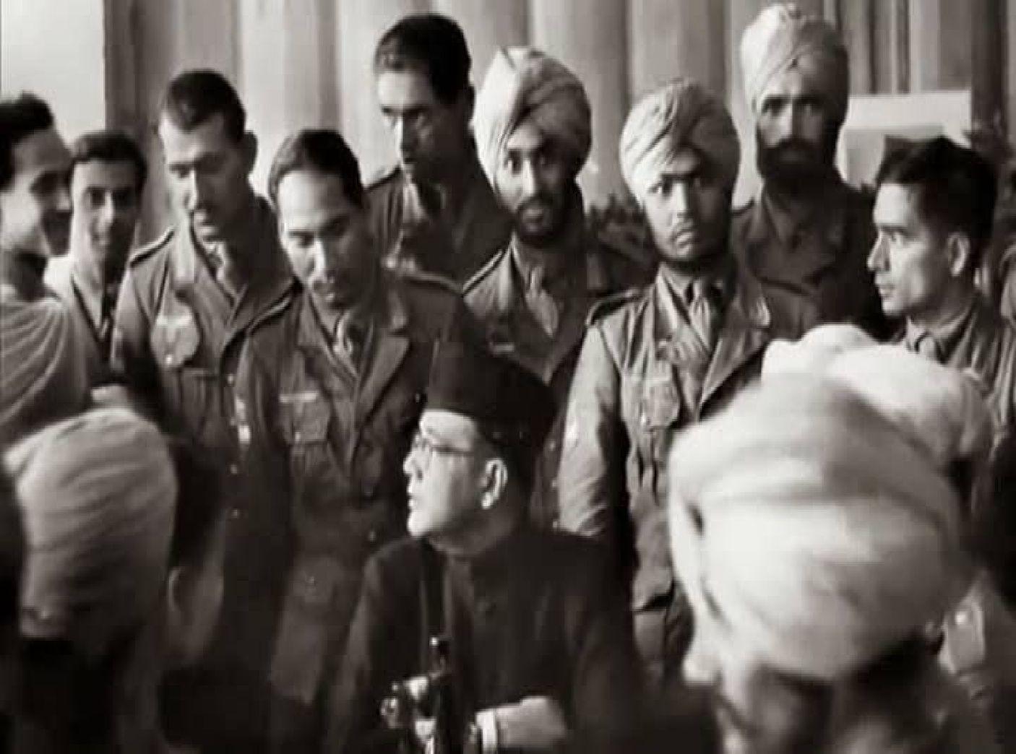
SUBHAS IN GERMANY

Slide 45
QUIT INDIA MOVEMENT
In August 1942, under tremendous pressure from the populace, Gandhi announces the ‘Quit India Movement.’
The Raj arrests Gandhi and his entire leadership – thus the movement becomes a decentralized assortment of self-propelled anti-colonial struggles.
From Berlin, using radio broadcasts, Subhas Chandra Bose urges his followers and revolutionaries to use whatever methods and tactics they can to combat the Raj.
The British brutally crush the struggles by August 1943, including using torture and rape as weapons of war.
Gandhi will categorically reject any association with the events of the Quit India Movement.

Slide 46
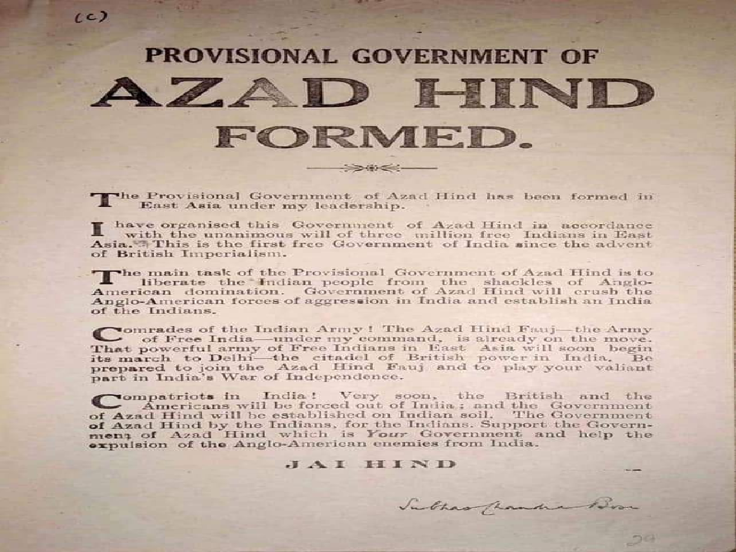
PROVISIONAL GOVERNMENT OF AZAD HIND FORMED

Slide 47
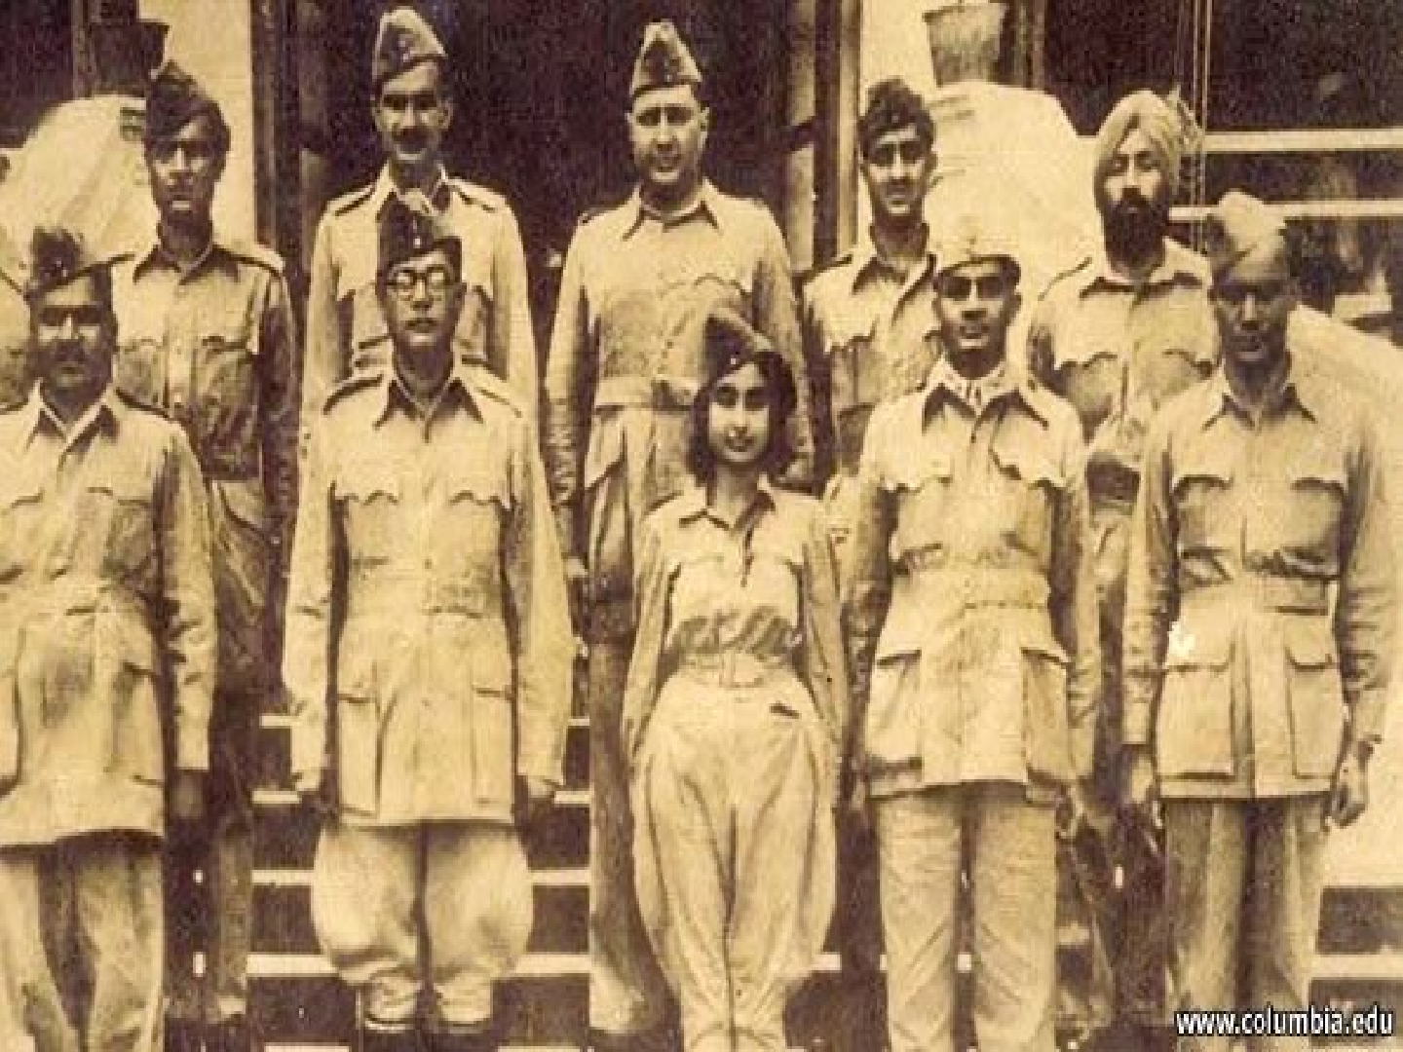
SUBHAS AND THE MEMBERS OF THE PROVINCIAL GOVT.

Slide 48
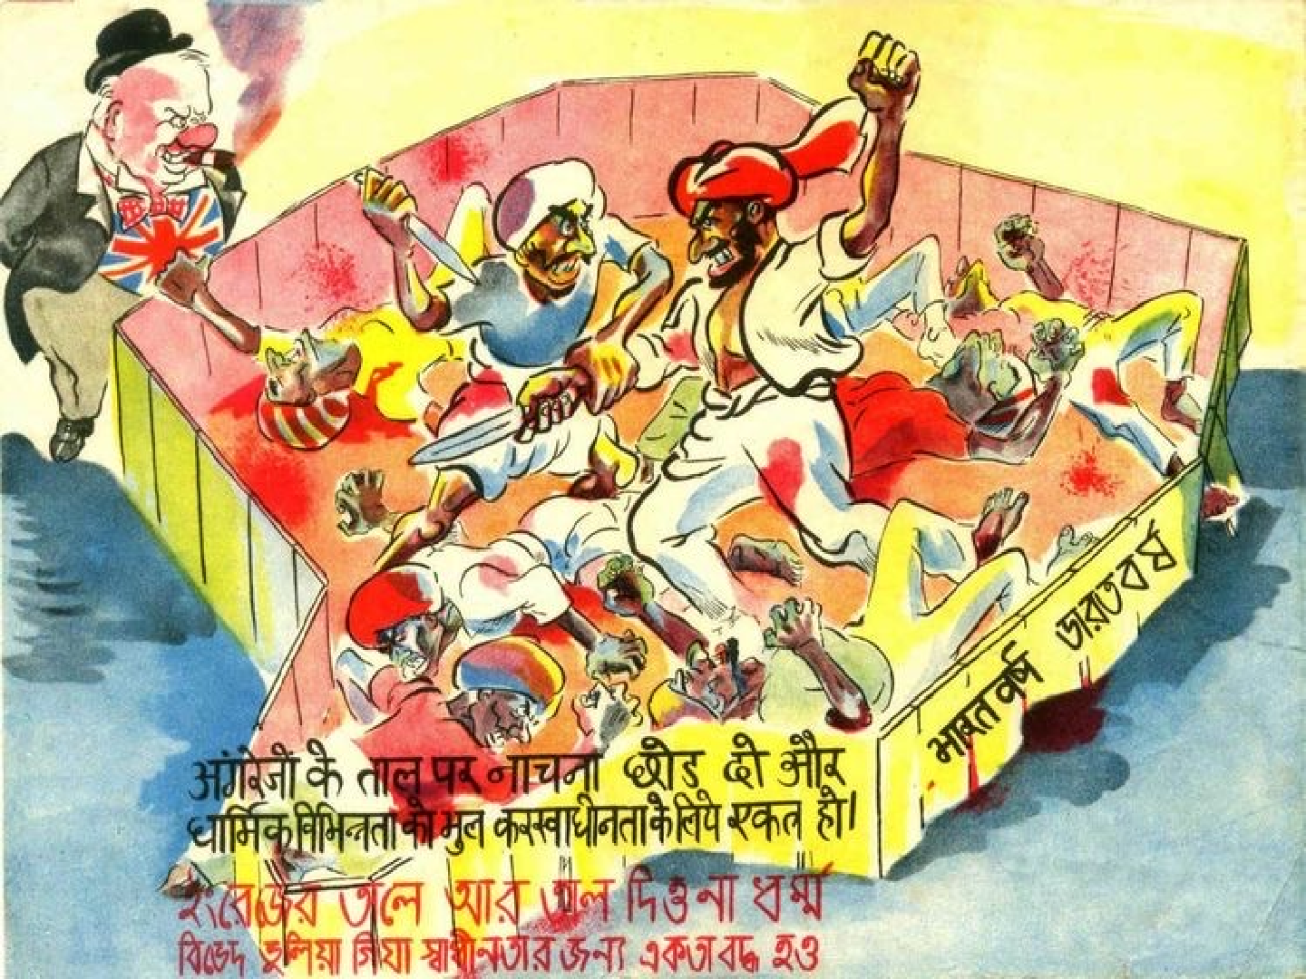
Poster : Depiction of Divide and Rule Politics of the Britishers by a local newspaper

Slide 49
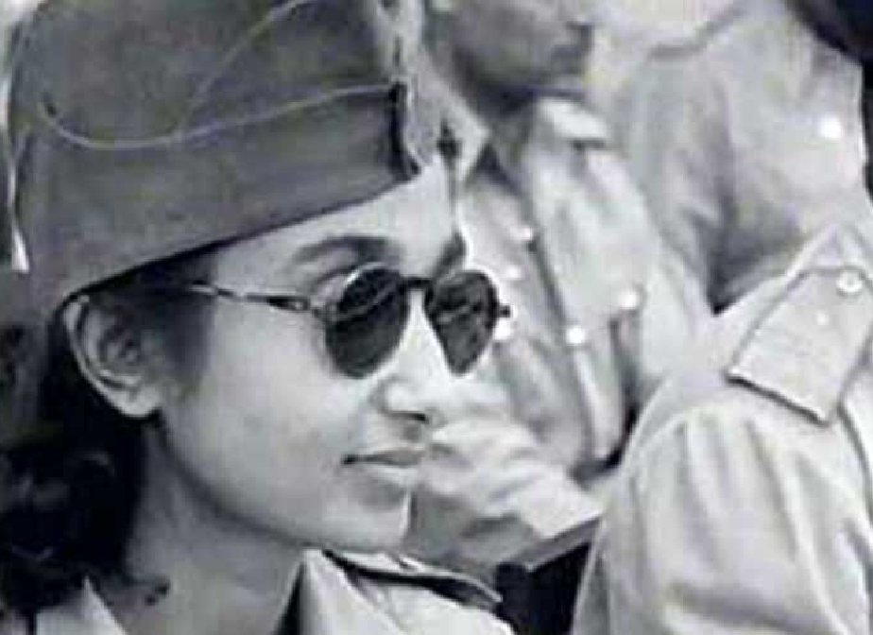

A unique feature of the ‘Free India Army’ or ‘Azad Hind Fauj’ in East Asia was the formation of a fully-trained and armed women’s only regiment of freedom fighters.
Subhas Chandra Bose chose Lakshmi Swaminathan, a brilliant young doctor in Singapore, to organize and head the unit.
The regiment saw heavy combat during the retreat from Burma in 1944-45.

Slide 50
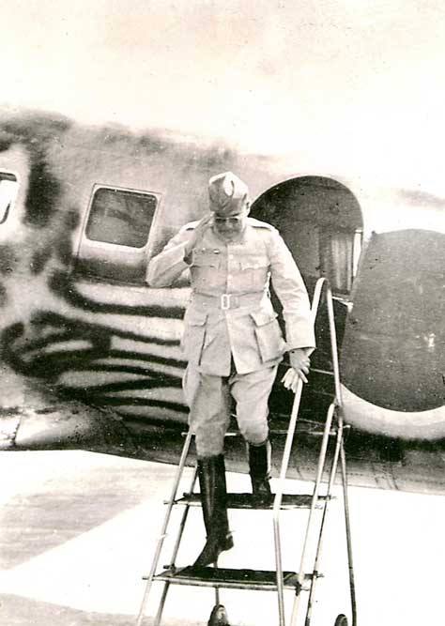
FORMATION OF PROVISIONAL GOVERNMENT OF FREE INDIA
AND THE THE DEATH OF SUBHAS BOSE
In 1943, Subhas Chandra Bose arrived in East Asia and established a provisional government of Free India and a larger army of liberation – the Indian National Army, composed of civilians from the subcontinent based in East Asia and mercenaries who had been captured by the Japanese.
During 1943–1944, the Indian National Army took part in the Imphal-Kohima campaign.
On 18 August 1945, while traveling onwards to meet with Soviet officials, the plane carrying Subhas Chandra Bose crashed in Taipei.
Subhas Chandra Bose died later that evening from burn wounds – the only major subcontinental leader to die on the battlefield.

Slide 51
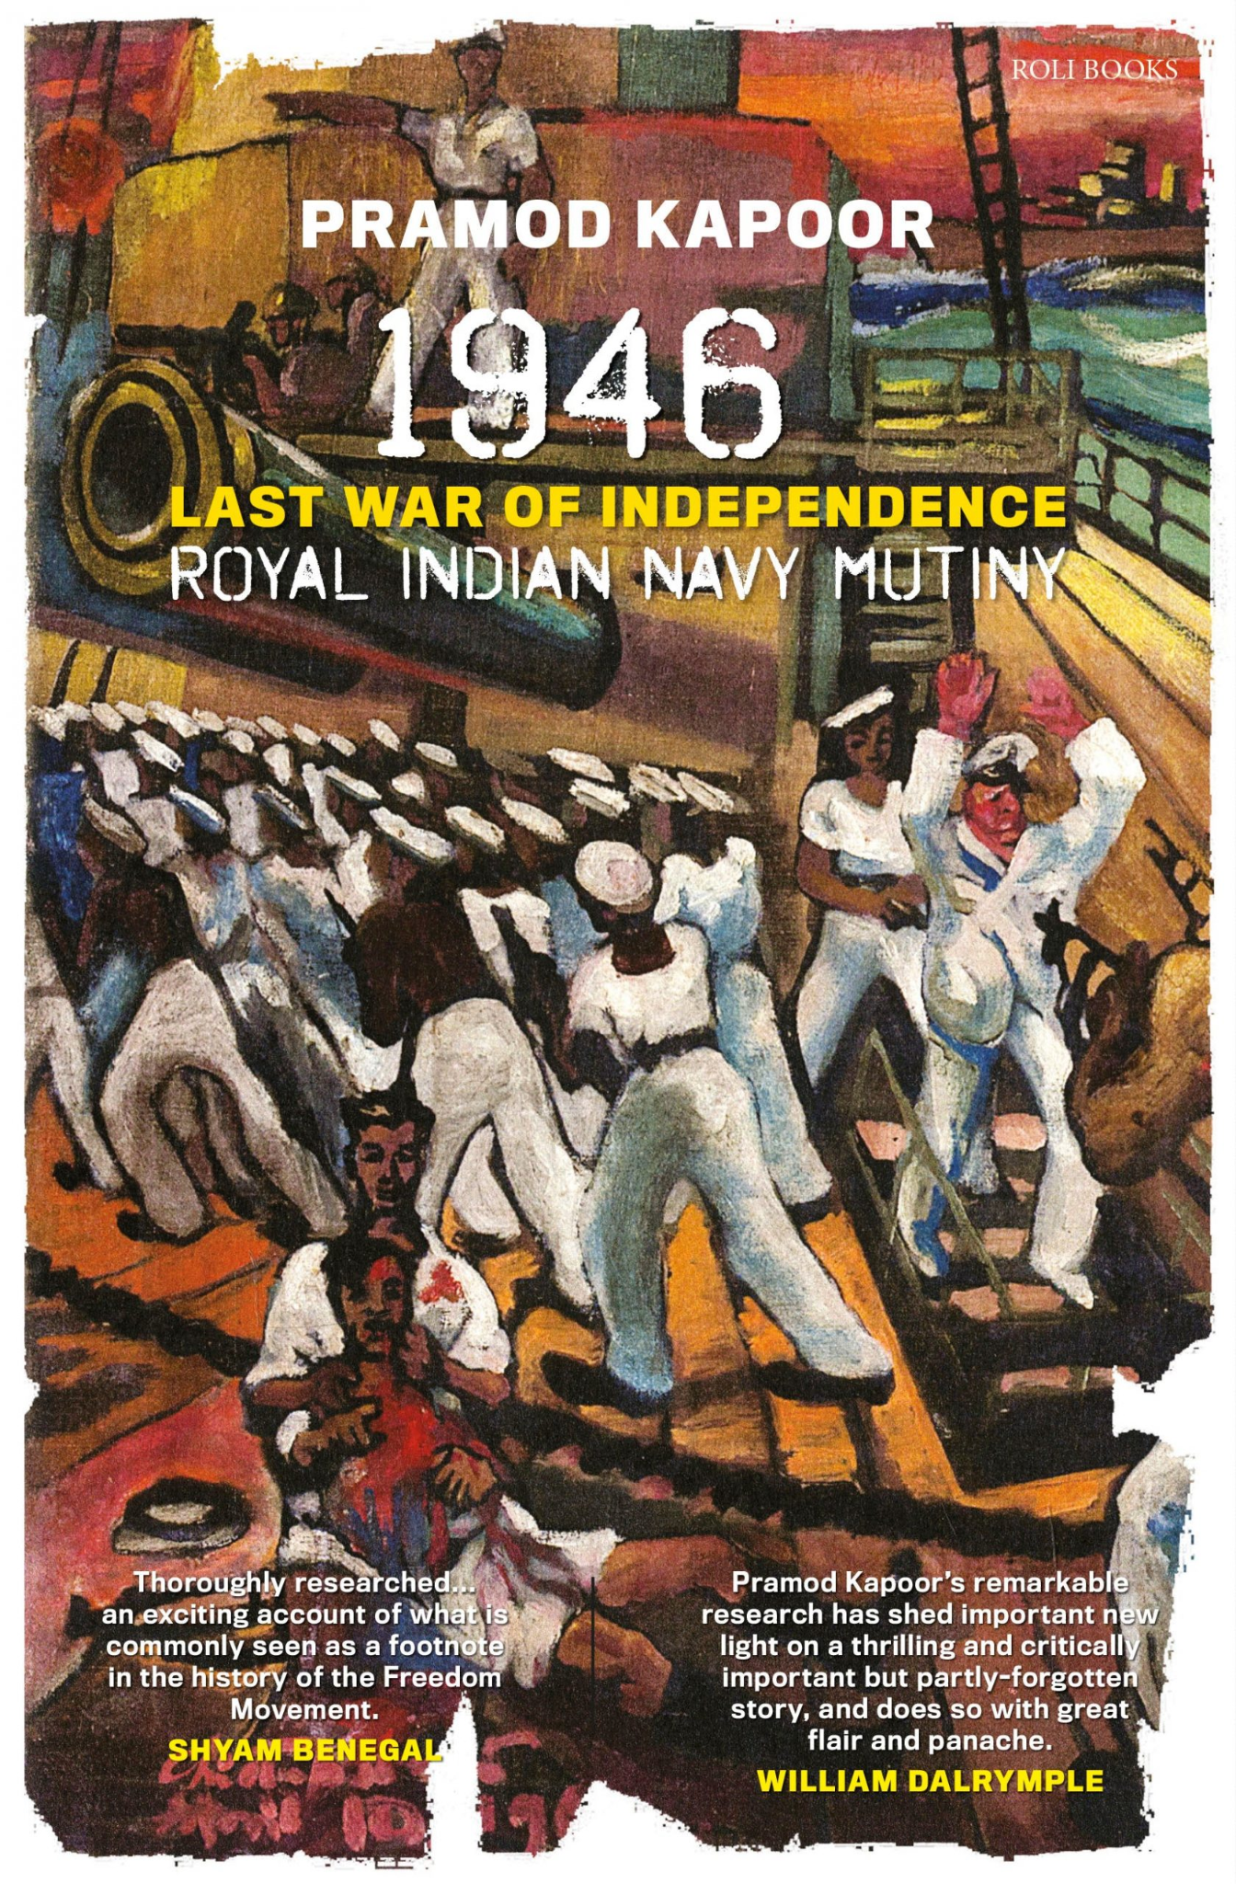
UPRISING OF THE ROYAL INDIAN NAVY
At the end of the war, the Raj foolishly decides to put officers and soldiers of the INA on trial for “treason.”
This leads to a massive subcontinent-wide groundswell of agitation and anger, and severely undermines the loyalty of the mercenaries to their British masters.
In early 1946, an uprising takes place onboard the ships of the mercenary navy – the so-called ‘Royal Indian Navy’ – with tens of thousands of sailors participating in ports across the subcontinent.
Sailors and civilians – Hindus and Muslims – fight side by side against British and mercenary forces.

Slide 52
LOGIC BEHIND BRITISH RAJ’S DEPARTURE FROM INDIA
British military and civilian officials conclude that to reassert complete control of the subcontinent would require a ‘reconquest.’ This was no longer possible in the aftermath of the war, with Britain financially and militarily exhausted and remaining resources needed elsewhere to hold on to other sectors of the empire.
The lack of complete trust in their mercenaries after the events of the INA officers' trials and the RIN uprising was entirely due to the actions of Subhas Chandra Bose and the Indian National Army.
A decision is taken by London to depart from the Raj by hoping to transfer power to its preferred collaborators in the Congress and the League.

Slide 53
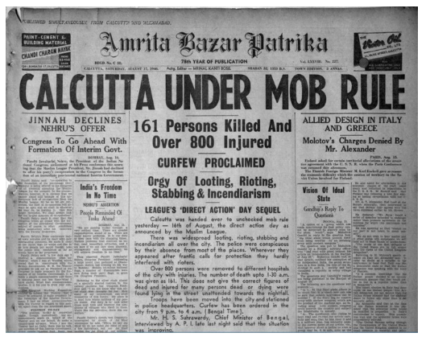
DIRECT ACTION DAY
A British Cabinet Mission is sent in early 1946 to propose a federal scheme for the provinces of the subcontinent, with provisions for individual provinces to ‘opt-out’ in favor of independence after a period of ten years.
After agreeing in principle to the scheme, Jawaharlal Nehru publicly rejected it.
In August 1946, Jinnah called for a ‘Day of Direct Action’ in response.
This culminated in the communal riots of Calcutta during August 16–19.

Slide 54
DEPARTURE OF THE RAJ: DOMINION STATUS IN AUGUST 1947

Slide 55
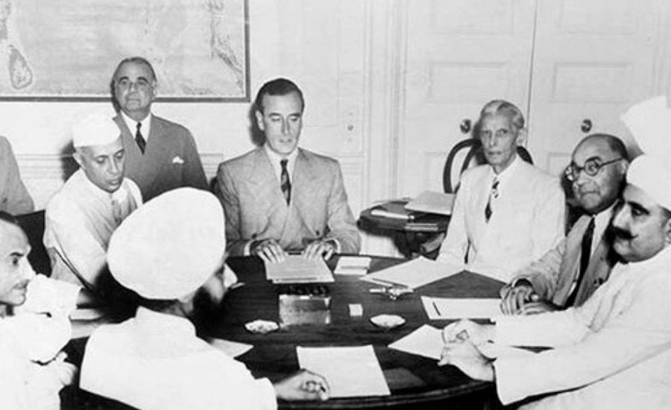
PARTITION OF INDIAN SUBCONTINENT AND DEPARTURE OF THE BRITISH RAJ (1/3)
In February 1947, London sends Louis Mountbatten as the last imperial viceroy with a mandate to depart by June 1948.
The empire was already renamed the ‘Commonwealth,’ and London demanded that independence must be preceded by ‘dominion status’ (a colony enjoying greater powers of self-governance).
The British relationship with Hindus and Muslims now went through a full circle since 1757 – friendship with Hindus and enmity towards Muslims up to the late 19th century, followed by friendship with Muslims and enmity towards Hindus. But now a decision was taken to favor the ‘Hindu’ Congress at the expense of the League.

Slide 56
PARTITION OF INDIAN SUBCONTINENT AND DEPARTURE OF THE BRITISH RAJ (2/3)
In June 1947, Mountbatten announces that the Raj will depart on August 14.
Popular wishes would be ignored; the existing colonial assemblies would make the choice between a Dominion India or Dominion Pakistan.
In Bengal and the Punjab, the only choice would be to divide the province.
The North-West Frontier Province – overwhelmingly Muslim – had supported Congress and opposed partition; yet now, at the last moment, it was abandoned by Congress, countering the claim of Congress to secularism.

Slide 57
PARTITION OF INDIAN SUBCONTINENT AND DEPARTURE OF THE BRITISH RAJ (3/3)
In Bengal, a proposal is put forward by Sarat Chandra Bose and H.S. Suhrawardy for a third independent entity – but this is opposed by Nehru, Gandhi, the Congress joining with the Hindu Mahasabha in support of partition, and ultimately the Raj.
One fear was that if a united Bengal was made a viable option, then the provinces of the southern part of the subcontinent, with Christians and strong anti-Brahmanical traditions in places such as Tamil Nadu, would have also opted to leave.
In the Bengal colonial assembly, the vote was 126 to 90 in favour of a united Bengal; but forced to vote separately on the question of partition, Hindus and Muslims voted along religious lines.

Slide 58
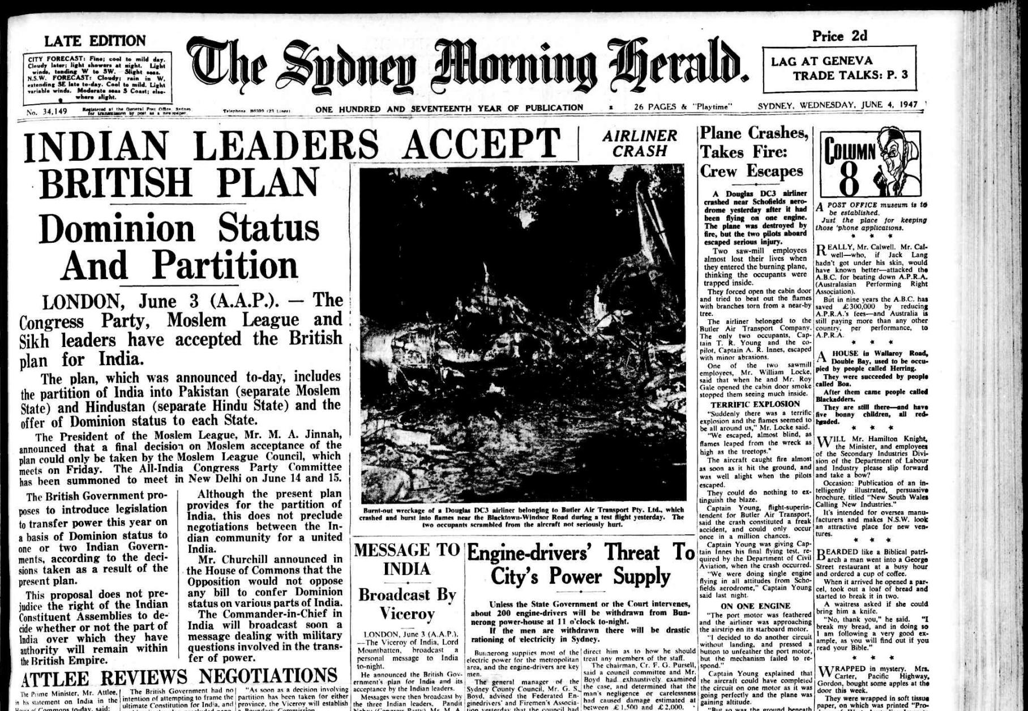
PARTITION AND VIOLENT MIGRATION
The refusal of the Raj to oversee an orderly partition – estimated at over one year and not less than six weeks – unleashed unimaginable brutality and horror in fratricidal killings in the northern portion of the subcontinent and the Punjab.
Anywhere over 4 million Hindus and Sikhs were forced to escape to East Punjab, and over 5 million Muslims were expelled to West Punjab.
Over 12 million people were forced to leave their homes as refugees and escape.
Countless thousands of women and girls from all three religious communities were kidnapped and disappeared.
The total number of people killed during the partition varies – but minimum estimates are over 1 million.

Slide 59
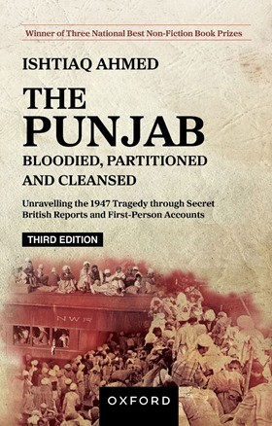
PARTITION AND VIOLENT MIGRATION
While there were some communal riots in Bengal – Calcutta and Noakhali – they were nothing on the scale or brutality witnessed in the Punjab.
There were also notable examples of non-communal movements – such as the ‘One-Third Share’ or ‘Tebhaga’ campaign – uniting Hindu and Muslim farmers led by activists such as Ila Mitra.
An additional reason for the hatred directed towards East Bengalis by the West Pakistan Punjab elites, after August 1947, was the refusal of East Bengalis to blindly exhibit hatred of India and Indians (post-August 1947), due to the horrific experiences of the fratricidal genocide that took place in the Punjab during partition.

Slide 60
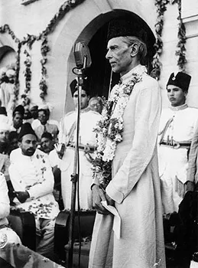
DOMINION STATUS OF INDIA AND PAKISTAN
The British Empire also treacherously – but not unexpectedly – abandons the so-called princely states, the royal collaborators after 1857, to their fates, primarily to Dominion India.
In the end, India and Pakistan do not become independent on 14/15 August 1947, but Dominion states until they promulgate their own constitutions.
The economic, political, bureaucratic, and military systems of both remain tied to the colonial master. In the case of Dominion Pakistan, Jinnah quickly moves closer to the new paramount world power and successor to the Raj in the world-system – the United States of America, with all its implications

Slide 61
READINGS FROM LAND OF TWO RIVERS BY NITISH SENGUPTA
OVER A DECADE OF HINDU-MUSLIM CAMARADERIE, PP. 330 – 348.
UNMAKING OF A NATION, PP. 367 – 388.
THE LAST HOUR OF UNITED BENGAL, PP. 450 – 487.
SECOND PARTITION OF BENGAL, PP. 486 – 496.

